Slide 1
Customer Relationship Management (CRM)
Name : Tanisha Choudhary
Registration Number : 209202069
Guide : Dr Somya Goyal

Slide 2
introduction
Introduction
CRM strategy
Advantages
Disadvantages
CRM Tools
CRM in IIFL

Slide 3
introduction
Customer Relationship Management (CRM) is a strategic approach that utilizes technology to manage and optimize interactions with current and potential customers. It focuses on fostering long-term relationships, improving customer satisfaction, and driving business growth through effective organization, automation, and synchronization of sales, marketing, and customer service processes.

Slide 4
Crm strategy
Understand your customers
Employee training and adoption
Data Quality and integration
Utilize AI (Zia)
Create personalized Customer Experience
Customer Feedback and Measurement
Continuous improvement
Security and Compliance
Customer acquisition and Retention
Provides Insights of data through various tools
Scalability

Slide 5
GOALS AND ADVANTAGES:
Provides business Insights helping business to make better decisions.
Improves the relationship between business owners and customers.
Customer satisfaction is meet more amicably because of better and Streamlined communication.
Data is more organized and used to profit both the parties.
Saves time, money and energy.
Increased Sales
DISADVANTAGE
High ​initial cost.
Training of employees required on a new platform.

Slide 6
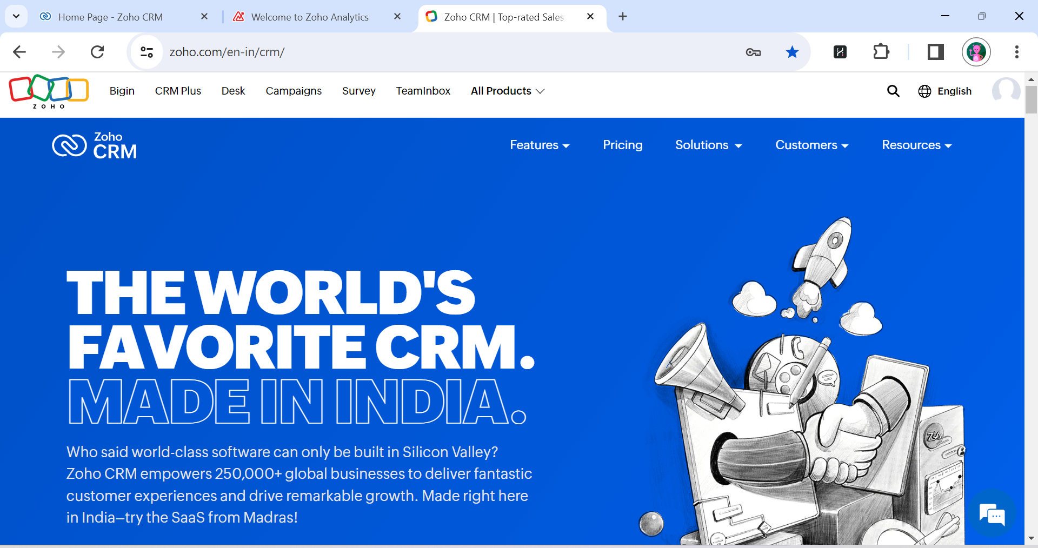
POPULAR CRM TOOLS
Salesforce CRM – Widely used cloud-based CRM platform offering a arrange of applications.
Microsoft Dynamics CRM- Integrates Microsoft Office, ERP capabilities and AI driven insights.
ZOHO CRM- Affordable pricing with an extensive range of tools available. Made in India technology with global presence.
Pipedrive- A sales focused CRM.

Slide 7
CRM IN IIFL

Slide 8
India Infoline Limited is one of the leading players in the financial services space in India.
Together with its subsidiaries – IIFL Home Finance Limited, IIFL Samasta Finance Limited and IIFL Open Fintech Private Limited, it provides a diverse range of loans and mortgages.
These include home loans, gold loans, business loans including loans against property and medium & small enterprise financing, micro finance, developer & construction finance and capital market finance; catering to both retail and corporate clients.
The company has a nationwide presence with a thriving network of 2600+ branches across 500+ cities.

Slide 9
Lead Management and Tracking
Customer Communication and service
Cross selling and Upselling
Better Decision making
Automated workflow allowing smooth flow of work
Customer Segmentation
Brings in new customers and helps in retaining the older ones
Customer Satisfaction
Drawing insights
Risk Management
Increased profits

Slide 10
Thank you

